Slide 1
Common Newborn Conditions: Respiratory and Birth Trauma
Jessie Marks DNP, ARNP

Slide 2
Learning objectives
Identify common respiratory issues in newborn and how to manage them
Understand the management of various birth traumas

Slide 3
First Breath
A critical step in the transition from intrauterine to extrauterine life is the conversion of the lung from a fluid-filled to gas exchange
This requires
aeration of the lungs
establishment of pulmonary circulation
ventilation of parenchyma
diffusion of oxygen and carbon dioxide
Neonate must overcome several forces that resist lung expansion:
viscosity of fetal lung fluid
resistance of the lung tissue
the forces of surface tension at the air-liquid interface.

Slide 4
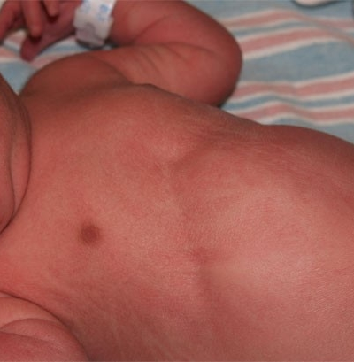
Respiratory Distress in newborn
Symptoms
>60 respirations a minute (with or without cyanosis)
Nasal flaring
Inspiratory stridor
Intercostal, subcostal and/or sternal retractions
Expiratory grunting
+/- desaturation

Slide 5
NONCARDIOPULMONARY | CARDIOVASCULAR | PULMONARY
Hypothermia or hyperthermia | Left-sided outflow obstruction | Upper airway obstruction
Hypoglycemia | Hypoplastic left heart | Choanal atresia
Metabolic acidosis | Aortic stenosis | Vocal cord paralysis
Drug intoxications, withdrawal | Coarctation of the aorta | Meconium aspiration
Polycythemia | Cyanotic lesions | Clear fluid aspiration
Central nervous system insult | Transposition of the great vessels | Transient tachypnea
Asphyxia | Total anomalous pulmonary venous return | Pneumonia
Hemorrhage | Tricuspid atresia | Pulmonary hypoplasia
Neuromuscular disease | Right-sided outflow obstruction | Primary
Werdnig-Hoffman disease |  | Secondary
Myopathies |  | Respiratory Distress Syndrome
Phrenic nerve injury |  | Pneumothorax
Skeletal abnormalities |  | Pleural effusions
Asphyxiating thoracic dystrophy |  | Mass lesions
 |  | Lobar emphysema
 |  | Cystic adenomatoid malformation
Notes:
Causes of respiratory distress
History, Physical exam, chest x-ray, echo (cardiac may be know prenatally, but not always) , consider CBC and blood cultures to rule out infection if risk factors.

Slide 6
Differentiation of Cyanotic Heart Disease From Pulmonary Disease
Variable | Cyanotic Heart Disease | Pulmonary Disease
History | Previous sibling with congenital heart disease | Maternal fever
 | Diagnosis of congenital heart disease by prenatal ultrasonography | MSAF
 |  | Preterm delivery
Physical examination | Cyanosis | Cyanosis
 | Gallop rhythm or murmur | Severe retractions
 | Single second heart sound | Split second heart sound
 | Large liver | Temperature instability
 | Mild respiratory distress
Chest radiograph | Increased heart size | Normal heart size
 | Decreased pulmonary vascularity (except in transposition of the great vessels or total anomalous pulmonary venous return) | Abnormal pulmonary parenchyma, such as total whiteout or patches of consolidation in pneumonia, fluid in the fissures in TTN or ground glass appearance in RDS
Arterial blood gas | Normal or decreased Paco2 | Increased Paco2
Respiratory Distress in the newborn. Reuter, S., Moser, C., and Baack, M. (2014). Pediatrics in Review. Volume 35, Issues 10.
Notes:
Respiratory Distress in the newborn. Reuter, S., Moser, C., and Baack, M. (2014). Pediatrics in Review. Volume 35, Issues 10.

Slide 7
Respiratory causes of distress in Term Newborn
Respiratory Distress Syndrome or Surfactant Deficiency Disorder
Rare in term infants, more common in preterm infants due to issues with insufficient surfactant.
Transient Tachypnea of the Newborn
Caused by retained fluid in lungs
More common in c-section and precipitous deliveries
Symptoms start from birth to 2 hours of age, last 12-24 hours, sometimes up to 72 hours
Meconium Aspiration Syndrome
Meconium is aspirated at birth causing airway obstruction, pneumonitis, and inactivates surfactant
Common in infants born after 40 weeks gestation.
Pulmonary Infection
Infected in utero, deliver or after birth
Fever is not typical, more often hypothermia
Notes:
MAS is common in infant's born after 40 weeks gestation.

Slide 8
Perinatal History
Respiratory Disease | Risk Factors
Transient Tachypnea of the Newborn | Caesarian section, precipitous delivery, late preterm or early term, maternal sedation or medication, fetal distress, gestational diabetes
Neonatal pneumonia | Maternal group B streptococcus carrier, chorioamnionitis, maternal fever, PROM, prematurity, perinatal depression
Respiratory Distress Syndrome or Surfactant Deficiency Disorder | Prematurity, gestational diabetes, male infant, multiple gestation
Meconium Aspiration Syndrome | MSAF, post term gestation, fetal distress or perinatal depression
Respiratory Distress in the newborn. Reuter, S., Moser, C., and Baack, M. (2014). Pediatrics in Review. Volume 35, Issues 10.

Slide 9
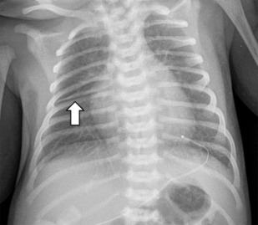
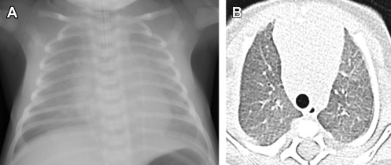
Diagnosis
RDS or surfactant dysfunction disorder
CXR: bilateral patchy or diffuse hazy opacities, low lung volumes
Transient Tachypnea of the Newborn
CXR: Perihilar interstitial opacities, small pleural effusions. Lung volumes may be normal or increased.
Notes:
chest x-ray is key. For TTNB repeat chest x-rays show improvement.
Respiratory Distress in the newborn. Reuter, S., Moser, C., and Baack, M. (2014). Pediatrics in Review. Volume 35, Issues 10.

Slide 10
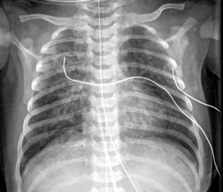
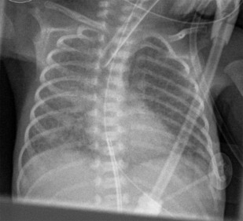
Meconium Aspiration Syndrome
Hyperinflation with asymmetric irregular opacities Pneumothorax in 10%–40% Pleural effusion in 10%–20%
Infection
Most commonly, bilateral alveolar opacities Findings may be identical to RDS or TTN CXR can be normal
Notes:
Respiratory Distress in the newborn. Reuter, S., Moser, C., and Baack, M. (2014). Pediatrics in Review. Volume 35, Issues 10.

Slide 11
Management
Respiratory Distress syndrome or Surfactant Dysfunction Disorder- Transfer to NICU for pulmonary support and surfactant
Transient Tachypnea of the Newborn
Maintaining a neutral thermal environment
For severe tachypnea provide nutrition through OG tube or IV fluids
Administering supplemental oxygen if needed
Meconium Aspiration syndrome- Transfer to NICU for pulmonary support and IV antibiotics
Pulmonary Infection- treat with antibiotics, transfer if NICU if more pulmonary support is needed
Notes:
TTNB is self limiting, management is supportive. Its usually a diagnosis of exclusion.

Slide 12
Birth Injuries

Slide 13
CLASSIFICATION | EXAMPLE
Soft tissue injuries* | Lacerations, abrasions, fat necrosis
Extracranial bleeding | Cephalohematoma, * subgaleal bleed
Intracranial hemorrhage | Subarachnoid, subdural, epidural, cerebral, cerebellar
Nerve injuries | Facial nerve, * cervical nerve roots (brachial plexus palsies, * phrenic nerve, Horner syndrome), recurrent laryngeal nerve (vocal cord paralysis)
Fractures | Clavicle, * facial bones, humerus, femur, skull, nasal bones
Dislocations | Extremities, nasal septum
Eye injuries | Subconjunctival * and retinal hemorrhages, orbital fracture, corneal laceration, breaks in Descemet membrane with corneal opacification
Spinal cord injuries
Visceral rupture | Liver, spleen
Scalp laceration * | Fetal scalp electrode, scalpel
Scalp abscess | Fetal scalp electrode
Birth Injuries in Neonates (2016). Akangire, Gangaram and Carter, Brian. Pediatrics in Review. Vol 37, Issue 11.
Notes:
Careful physical examination is important as identification of a birth injury will impact your management of the newborn.

Slide 14
Risk Factors | Related Injuries
Forceps delivery | Facial nerve injuries
Vacuum extraction | Depressed skull fracture, subgaleal hemorrhage
Forceps/vacuum/forceps + vacuum | Cephalohematoma, intracranial hemorrhage, shoulder dystocia, retinal hemorrhages
Breech presentation | Brachial plexus palsy, intracranial hemorrhage, gluteal lacerations, long bone fractures
Macrosomia | Shoulder dystocia, clavicle and rib fractures, cephalohematoma, caput succedaneum
Abnormal presentation (face, brow, transverse, compound) | Excessive bruising, retinal hemorrhage, lacerations
Prematurity | Bruising, intracranial and extracranial hemorrhage
Precipitous delivery | Bruising, intracranial and extracranial hemorrhage, retinal hemorrhage
Birth Injuries in Neonates (2016). Akangire, Gangaram and Carter, Brian. Pediatrics in Review. Vol 37, Issue 11.

Slide 15
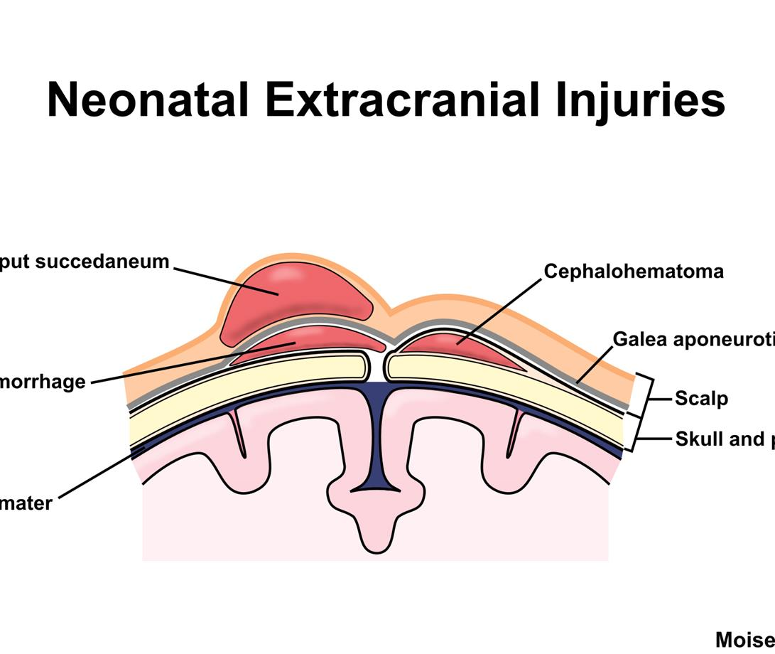
Head Injuries
Caput succedaneum
Scalp swelling above periosteum that crosses the suture lines
Erythema, petechiae and ecchymosis may be present
Treatment: watchful waiting, monitor for hyperbilirubinemia
Typically resolve in 4-6 days
Cephalohematoma
Subperiosteal bleeding that does not cross suture lines
Often unilateral but can have bilateral cephalohematomas
Treatment: Watchful waiting, monitor for hyperbilirubinemia

Slide 16
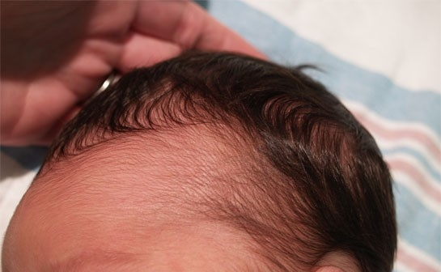
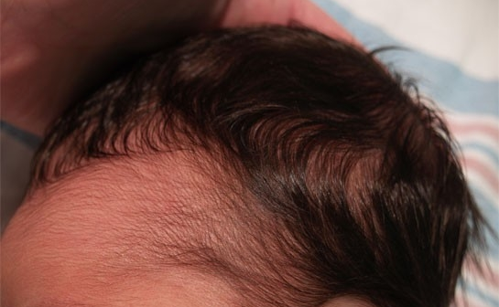
Subgaleal hemorrhage
Blood accumulation between the periosteum of the skull and the epicranial aponeurosis
Diffuse and fluctuant head swelling
Tachycardia and pallor secondary to blood loss
Obtain CBC, coagulation labs, serial OFC
If worsening tachycardia or pallor, or increasing OFC transfer to NICU for IV fluids and blood
Notes:
In the pictures the hand is behind the head and moving the mass forward, positive wave form.

Slide 17
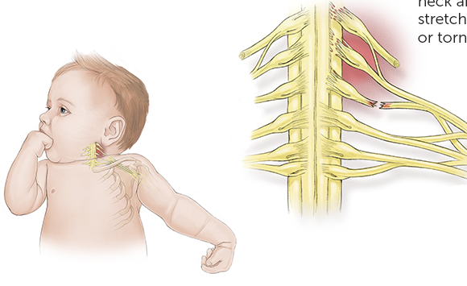
Brachial Plexus Injury
Occurs in 0.5 to 2.5 per 1,000 live births
Paralysis of upper arm muscles following trauma to spinal roots C5 to T1
4 main types:
Erb-Duchenne palsy: injury to C5-6, most common form of brachial plexus palsy
Klumpke palsy: injury to C8 to T1
Total arm paralysis: if all nerve roots are involved
Horner syndrome: miosis, ptosis, and enophthalmos; damage to sympathetic outflow via nerve root T1
Management
Refer to Physical therapy
Refer to Seattle Children's Brachial Plexus clinic – evaluated by PT, Ortho, Plastic surgery and radiology.
Notes:
Physical or occupational therapy, Splinting, Botulinum toxin injections, Surgery, A combination of these treatments

Slide 18
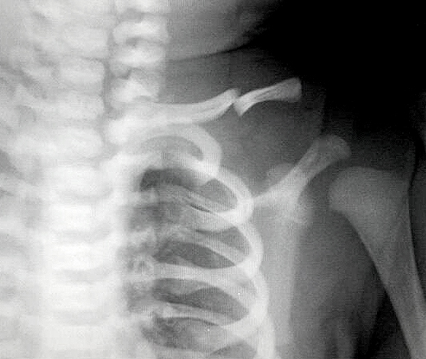
Fractures
Skull Fracture
Uncommon, usually simple linear fracture, good prognosis
Facial bone fracture
Can occur during passage through birth canal
Any facial fracture with respiratory distress warrants surgical evaluation
Clavicle Fracture
Edema, immobility of affected extremity, crying when affected extremity is moved, crepitus
Obtain clavicle x-ray
Management- watchful waiting, immobilization of arm
Humerus Fracture
0.2 per 1,000 deliveries
Decreased arm movement, localized crepitus, pain with palpation
Obtain arm x-ray
Immobilize with elbow at 90 degrees
Monitoring and close follow up

Slide 19
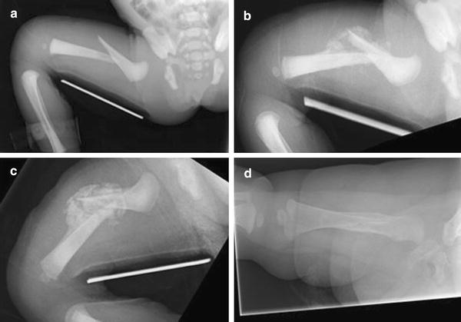
Femur Fracture
0.13 per 1,000 deliveries
Asymptomatic or pain response to handling, “pop” or “snap” on delivery
Pavlik harness is an optional treatment in newborns
Monitoring and close follow up

Slide 20
References
The Neonate. Rozance, P.J. and Rosenberg, A. A. Obstetrics: Normal and Problem Pregnancies, (2017). Ch 22, 468-498.
Respiratory Distress in Neonates. Liszewski, M. C., Stanescu, A. L., Phillips, G.S. and Lee, E. Y. (2017). Radiologic Clinics of North America. Volume 55, Issue 4, pg 629-644.
Birth Injuries in Neonates (2016). Akangire, Gangaram and Carter, Brian. Pediatrics in Review. Vol 37, Issue 11.
Respiratory Distress in the newborn. Reuter, S., Moser, C., and Baack, M. (2014). Pediatrics in Review. Volume 35, Issues 10.
Birth Injuries. (2019). Prazad, P.A., Rajpal, M. N., Mangutern, H. H. and Puppala B.L. Fanaroff and Martin’s Neonatal –Perinatal Medicine 11th Edition. 29, 458-488

